Slide 1


PANIMALAR ENGINEERING COLLEGE
Department of Computer Science and Engineering
CS8811 PROJECT WORK
HUMAN STRESS DETECTION IN AND THROUGH SLEEP USING AI
Team Members with Register number:
SURENDHAR A(211419104275)
THARUN A(211419104290)
RAJARAJAN P(211419104210)
Project Guide:Dr.S.BalajiB.Tech,M.E,PhD
Batch Number:C5

Slide 2
HUMAN STRESS DETECTION IN AND THROUGH SLEEP BY USING AI

Slide 3
INTRODUCTION:
Stress plays an integral role in influencing one's decision-making capability, attention span, learning, and problem-solving capacity. Stress detection and modeling have been active areas of research in the fields of psychology and computer science in recent times. Psychologists quantify stress using affective states, which is the experience of feeling the underlying emotional state. Most of the work in classifying human stress was achieved using user-dependent models, incapable of generalizing to a new user. This causes new user to spend a significant amount of their time in training the model to predict their affective states. There is an urgent need to treat basic mental health problems that prevail among children which may lead to complicated problems, if not treated at an early stage. Machine learning Techniques are currently well suited for analyzing medical data and diagnosing the problem. The attributes have been reduced by analysing Features over the full attribute data set. The accuracy over the selected attribute set on various machine learning algorithms have been compared.

Slide 4
LITERATURE REVIEW:
Title : Machine Learning-based Approach for Depression Detection in Twitter Using Content and Activity Features
Author: Hatoon AlSagri, Mourad Ykhlef
Year : 2020
Social media channels, such as Facebook, Twitter, and Instagram, have altered our world forever. People are now increasingly connected than ever and reveal a sort of digital persona. Although social media certainly has several remarkable features, the demerits are undeniable as well. Recent studies have indicated a correlation between high usage of social media sites and increased depression. The present study aims to exploit machine learning techniques for detecting a probable depressed Twitter user based on both, his/her network behavior and tweets. For this purpose, we trained and tested classifiers to distinguish whether a user is depressed or not using features extracted from his/her activities in the network and tweets. The results showed that the more features are used, the higher are the accuracy and F-measure scores in detecting depressed users. This method is a data-driven, predictive approach for early detection of depression or other mental illnesses. This study’s main contribution is the exploration part of the features and its impact on detecting the depression level..

Slide 5
LITERATURE REVIEW:
Title : Predicting the Utilization of Mental Health Treatment with Various Machine Learning Algorithms
Author: MEERA SHARMA, SONOK MAHAPATRA
Year : 2020
In 2017, about 792 million people (more than 10% of the global population) lived their lives with a mental disorder [24]– 78 million of which committed suicide because of it. In these unprecedented times of COVID-19, mental health challenges have been even further exacerbated as home environments have been proven to be major sources of the creation and worsening of poor mental health. Additionally, proper diagnosis and treatment for people with mental health disorders remains underdeveloped in modern-day’s society due to the widely ever-present public stigma attached to caring about mental health. Recently there have been attempts in the data science world to predict if a person is suicidal (and other diagnostic approaches) yet all face major setbacks. To begin, big data has many ethical issues related to privacy and reusability without permission—especially in regards to using feeds from social media. Additionally, people diagnosed with specific mental health conditions may not actually seek treatment, so data may be incorrect. In this research, we address both of these problems by using anonymous datasets to predict the answer to a different question—whether or not people are seeking mental health treatment. We also use a large variety of machine learning and deep learning classifiers and predictive models to predict with a high accuracy rate through statistical analysis.

Slide 6
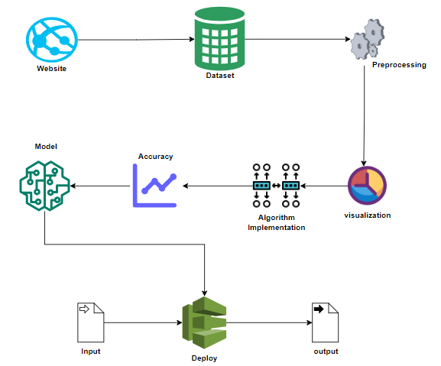
System Architecture:

Slide 7
MODULE DESCRIPTION:
Data Pre-processing:
Validation techniques in machine learning are used to get the error rate of the Machine Learning (ML) model, which can be considered as close to the true error rate of the dataset. If the data volume is large enough to be representative of the population, you may not need the validation techniques. However, in real-world scenarios, to work with samples of data that may not be a true representative of the population of given dataset. To finding the missing value, duplicate value and description of data type whether it is float variable or integer. The sample of data used to provide an unbiased evaluation of a model fit on the training dataset while tuning model hyper parameters.

Slide 8
Data visualization
Data visualization is an important skill in applied statistics and machine learning. Statistics does indeed focus on quantitative descriptions and estimations of data. Data visualization provides an important suite of tools for gaining a qualitative understanding. This can be helpful when exploring and getting to know a dataset and can help with identifying patterns, corrupt data, outliers, and much more. With a little domain knowledge, data visualizations can be used to express and demonstrate key relationships in plots and charts that are more visceral and stakeholders than measures of association or significance. Data visualization and exploratory data analysis are whole fields themselves and it will recommend a deeper dive into some the books mentioned at the end.

Slide 9
TESTING
White Box Testing
White-box testing (also known as clear box testing, glass box testing, transparent box testing, and structural testing) is a method of testing software that tests internal structures or workings of an application, as opposed to its functionality (i.e. black-box testing). In white-box testing an internalperspective of the system, as well as programming skills, are used to design test cases. The tester chooses inputs to exercise paths through the code and determine the appropriate outputs. This is analogous to testing nodes in a circuit, e.g. in-circuittesting (ICT). While white-box testing can be applied at the unit, integration and system levels of the software testing process, it is usually done at the unit level. It can test paths within a unit, paths between units during integration, and between subsystems during a system–level test. Though this methodof test design can uncover many errors or problems, it might not detect unimplemented parts of the specification or missing requirements.White-box test design techniques include:
Control flow testing
Data flow testing
Branch testing
Path testing
Statement coverage
Decision coverage

Slide 10
Existing System:
A novel JCCB-FSC method to detect stress in decision-making. In particular, we used TSST and BART experimental paradigms to simulate the decision-making process of medical students under stress. Different from previous research that focused on simply grading stress in no specific situation, we aimed to detect stress in the decision-making process, and provide clues for stress detection in the decision-making situation of medical staff in the future. Stress is one of the contributing factors affecting decision-making. Therefore, early stress recognition is essential to improve clinicians’ decision-making performance. Functional near-infrared spectroscopy (fNIRS) has shown great potential in detecting stress. However, the majority of previous studies only used fNIRS features at the individuallevel for classificationwithout consideringthe correlations among channels corresponding to the brain, which may provide distinguishing features

Slide 11
Disadvantages:
This is a complex process.
Performance metrics are not calculated.
Deployment is not implemented.

Slide 12
Proposed System:
Stress datas from different sources would be combined to form a generalized dataset. In this section of the report will load in the data, check for cleanliness, and then trim and clean given dataset for analysis. The data set collected for predicting given data is split into Training set and Test set. Generally, 7:3 ratios are applied to split the Training set and Test set. The Data Model which was created using machine learning algorithms are applied on the Training set and based on the test result accuracy, Test set prediction is done. For the prediction of the stress, ML prediction model is effective because it is strong in preprocessing outliers, irrelevant variables, and a mix of continuous, categorical and discrete variables.

Slide 13
Advantages:
Accuracy may be improvised.
Performance metrics will be compared.
Project will be deployed

Slide 14
SYSTEM STUDY
Aim:
Stress Detection is one of the major factors in our healthcare domain. There are lot of patients who are actively present in the world. It is difficult to find the stress detection. So this project can easily find out the stress detection.
Objectives:
The goal is to develop a machine learning model for stress detection Prediction, to potentially replace the updatable supervised machine learning classification models by predicting results in the form of best accuracy by comparing supervised algorithm.

Slide 15
LIST OF MODULES:
Data Pre-processing
Data Analysis of Visualization
Implementing Algorithm 1
Implementing Algorithm 2
Implementing Algorithm 3
Implementing Algorithm 4
Deployment

Slide 16
TECHNOLOGY STACK:
Software Requirements
Operating System : Windows 10 or later
Tool : Anaconda with Jupyter Notebook
Hardware requirements:
Processor : Intel i3
Hard disk : minimum 80 GB
RAM : minimum 2 GB

Slide 17
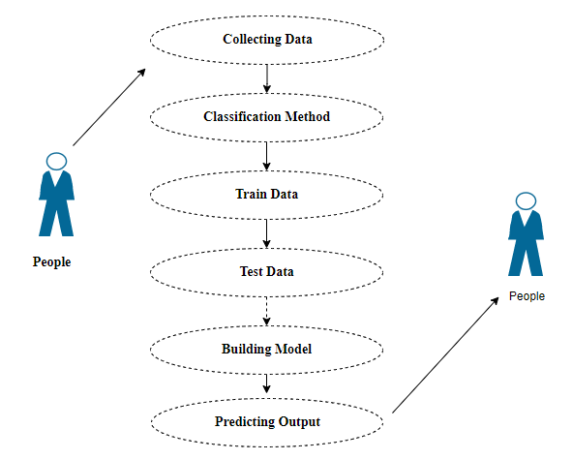
Use Case Diagram:

Slide 18
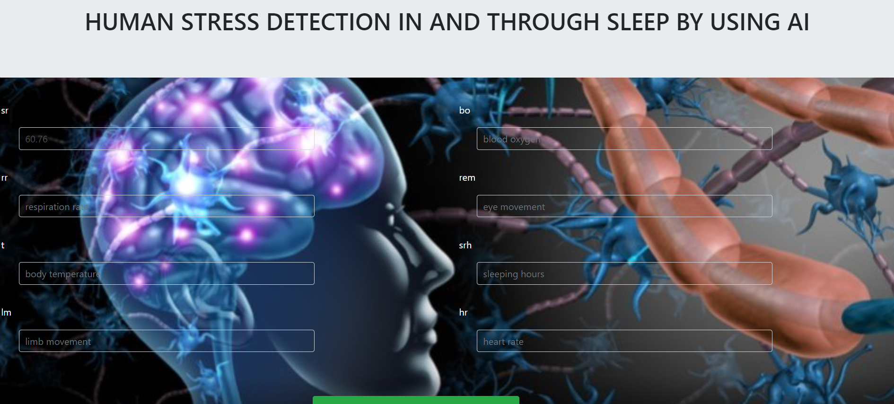
OUTPUT SCREENSHOT:

Slide 19
Conclusion:
The analytical process started from data cleaning and processing, missing value, exploratory analysis and finally model building and evaluation. The best accuracy on public test set of higher accuracy score algorithm will be find out. The founded one is used in the application which can help to find the Human Stress of the patient.

Slide 20
Future Work
Deploying the project in the cloud.
To optimize the work to implement in the IOT system.

Slide 21
REFERENCES:
Prediction of mental disorder for employees in IT industry (Sandhya P.Mahekkanesaria)(International journal of innovative technology and exploring engineering IJITEE)
Machine learning -based approach for depression detection (Hatoon Alsagri,Mourad Yklef)
Prediction the utilization of mental health treatment with various machine learning algorithms.(Meera sharma,sonak Mahapatra.
Artificial intelligence for mental health and mental illness(Sarah graham,colin deep)
K. Sengupta, "Stress Detection: A Predictive Analysis," 2021 Asian Conference on Innovation in Technology (ASIANCON), PUNE, India, 2021, pp. 1-6, doi: 10.1109/ASIANCON51346.2021.9544609.

